Slide 1

Chapter 7
Run-Time Environments
Unit 4

Slide 2
Unit 4
Runtime Environment and Code generation: Static VS Dynamic storage, stack allocation scheme, Design issues in code generation, Basic blocks and flow graphs; Optimization in the basic blocks; Implementation of simple code generator, code generation algorithm; Peep hole optimization; register allocation and assignments; optimal code generation for expressions.

Slide 3
Outline
Compiler must do the storage allocation and provide access to variables and data.
Compiler creates & manages a runtime environment in which its target programs are created & executed.
Memory management
  Stack allocation
  Heap management
  Garbage collection

Slide 4
Issues
Layout
Allocation of storage location for the objects in the source program
Mechanism used by target program for accessing variables
Linkage between procedures
Mechanism used for passing parameters
Interface to OS , I/O devices & other programs.

Slide 5
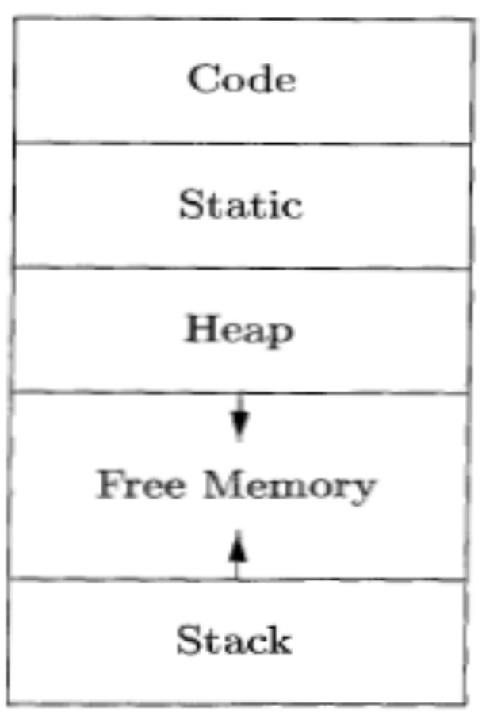
Storage Organization
Runtime representation of an object program in the logical address space (for Linux);consists of data and program areas with alignment.
LOW
Although an array of ten characters needs only enough bytes to hold ten
characters, a compiler may allocate 12 bytes to get the proper alignment with 4bytes width for each line.
HIGH

Slide 6
Runtime memory details
Code area, usually in the low end of memory, comprises executable target code generated by compiler. Its size is fixed & determined statically.
Static area is statically determined area holding the global constants, and data generated by the compiler. Advtg. Addresses can be compiled into target code.
Stack and Heap areas are at the opposite ends of the remainder of the address space to maximize the space utilization. These are dynamic; their size can change as the program executes. The stack is used to store data structures called activation records that get generated during procedure calls. In practice, the stack grows towards lower addresses, the heap towards higher. In the discussions here we assume that the stack grows towards higher addresses so as to get positive offsets for notational convenience
The heap is used for managing long-lived data allocated through malloc/calloc.
Notes:
An activation record is used to store information about the status of the machine, such as the value of the program
counter and machine registers, when a procedure call occurs.
When control
returns from the call, the activation of the calling procedure can be restarted
after restoring the values of relevant registers and setting the program counter
to the point immediately after the call. Data objects whose lifetimes are contained
in that of an activation can be allocated on the stack along with other
information associated with the activation

Slide 7
Stack VS. Heap
Stack
Dynamic storage
Grows towards lower address
Activation record for procedure calls
No garbage collector (GC)
Only procedure data.
Heap
Dynamic storage
Grows towards higher address
Stores malloc kind of long lived data
GC is supported
All data are considered.

Slide 8
Static vs. Dynamic Allocation
Static: Compile time, Dynamic: Runtime allocation
Static allocation is by looking at the program; dynamic allocation for execution time happenings
‘Static’ storage space is used for static allocation, whereas stack & heap are used for dynamic storage allocation
Many compilers use some combination of following
  Stack storage: for local variables of procedures, parameters and so on
  Heap storage: Data that may outlive the call to the procedure that created it. It is a memory that allows objects or other data elements to obtain storage when they are created and to return that storage when they are invalidated.
  Stack allocation is a valid allocation for procedures since procedure calls are nested

Slide 9
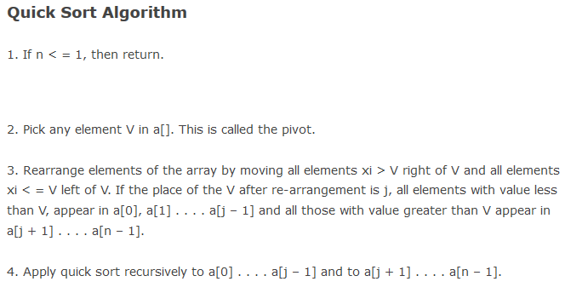

Slide 10
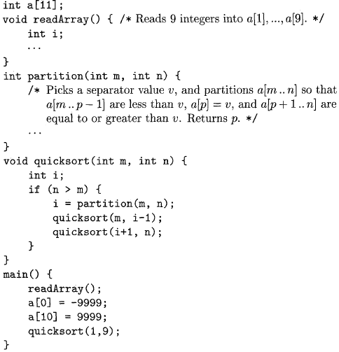
Sketch of a quicksort program: nesting of procedure calls
Note: Sentinel element a[0] is set to a value lower than any data value and element a[10] is set to a value higher than any data value. So total 11 elements need to be allocated with int a[11].

Slide 11
Procedure activation with example program
The program reads nine integers into an array a and sorts them using the recursive quicksort algorithm.
The main function has three tasks. It calls readArray, sets the sentinels (first& last elements of a), and then calls quicksort on the entire data array.
In the example execution, the call to partition(1,9) returns 4 (pivot), so a[l] through a[3] hold elements less than the chosen separator value v, while the larger elements are in a[5] through a[9].
Note: if an activation of procedure p calls procedure q, then that activation of q must end before the activation of p can end.

Slide 12
Activation of procedures: 3 cases
The activation of callee q terminates normally. Then in essentially any language, control resumes just after the point of p at which the call to q was made.
The activation of q, or some procedure q called, either directly or indirectly, aborts; i.e., it becomes impossible for execution to continue. In that case, p ends simultaneously with q.
The activation of q terminates because of an exception that q cannot handle. Procedure p may handle the exception, in which case the activation of q has terminated while the activation of p continues, although not necessarily from the point at which the call to q was made. If p cannot handle the exception, then this activation of p terminates at the same time as the activation of q, and presumably the exception will be handled by some other open activation of a procedure.

Slide 13
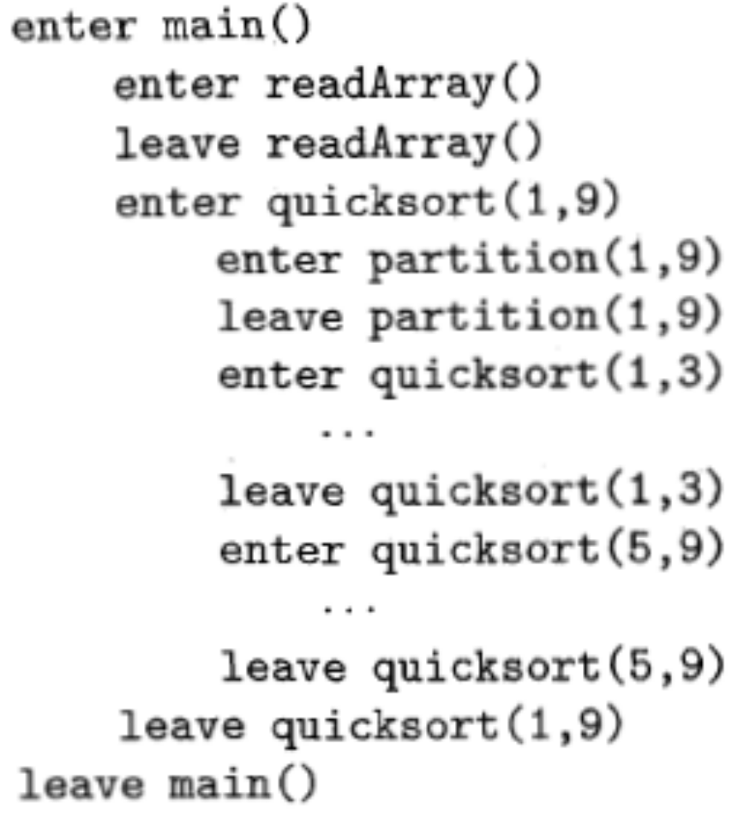
Activation for Quicksort

Slide 14
Activation trees
We represent the activations of procedures during the running of an entire program by a tree, called an activation tree.
An activation tree shows the way control enters and leaves activations.
Each node corresponds to one activation, and the root is the activation of the "main" procedure that initiates execution of the program. At a node for an activation of procedure p, the children correspond to activations of the procedures called by this activation of p.
We show these activations in the order that they are called, from left to right. Notice that one child must finish before the activation to its right can begin.
Functions are represented by the first letters of their names. This tree is only one representation, since the arguments of subsequent calls, and also the number of calls along any branch is influenced by the values returned by partition.

Slide 15
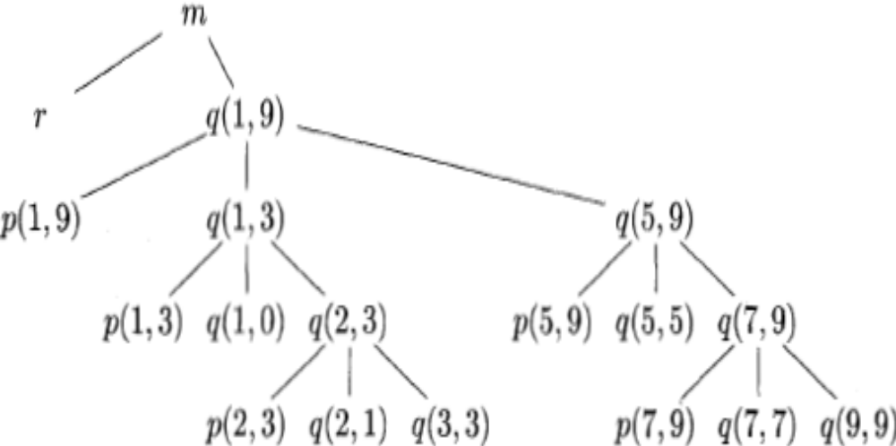
Activation tree representing calls during an execution of Quicksort program
m: main function & r : readArray

Slide 16
Activation records
Procedure calls and returns are usually managed by a run-time stack called the control stack.
Each live activation of procedure has an activation record (sometimes called a frame).
The root of activation tree is at the bottom of the stack and the sequence of activation records are on the stack corresponding to the path in the activation tree.
The current execution path specifies the content of the stack with the last activation has record in the top of the stack.

Slide 17
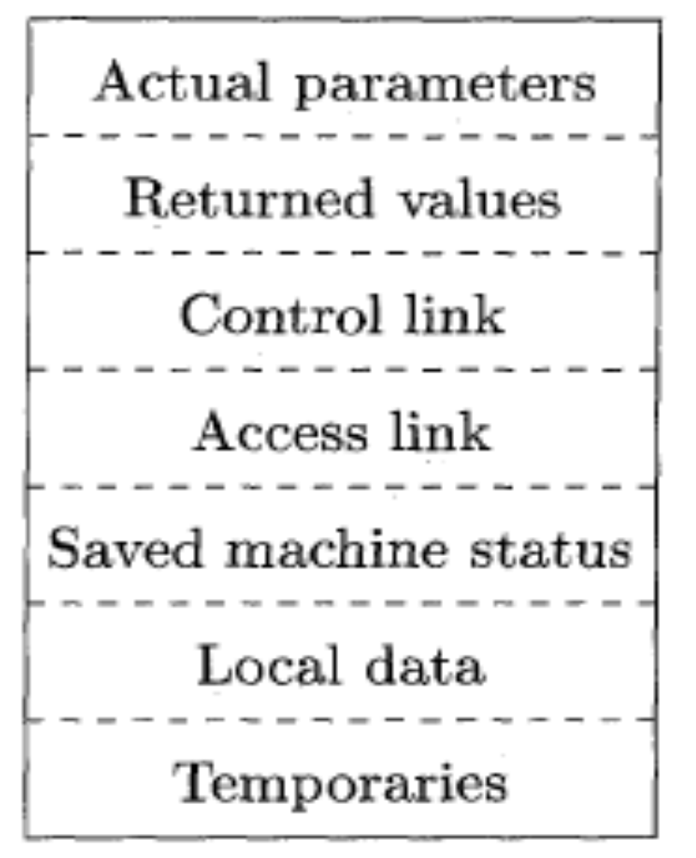
A General Activation Record
Actual parameters of the calling procedure
Return value: used by the called procedure to return a value to calling procedure
Control link (optional): points to activation record of caller.
Access link (optional): refers to non-local data held in other activation records.
Machine status: holds the information about status of machine just before the function call.
Local data: hold the data that is local to the execution of the procedure.
Temporary values: stores the values that arise in the evaluation of an expression.

Slide 18
Activation Record
Temporary values: keeps values that cannot be held in registers.
Local data
A saved machine status: comprises return address (value of program counter), and register contents used by the calling procedure.
An “access link”
A control link
Space for the return value of the called function
The actual parameters used by the calling procedure, normally kept in registers for efficiency.

Slide 19
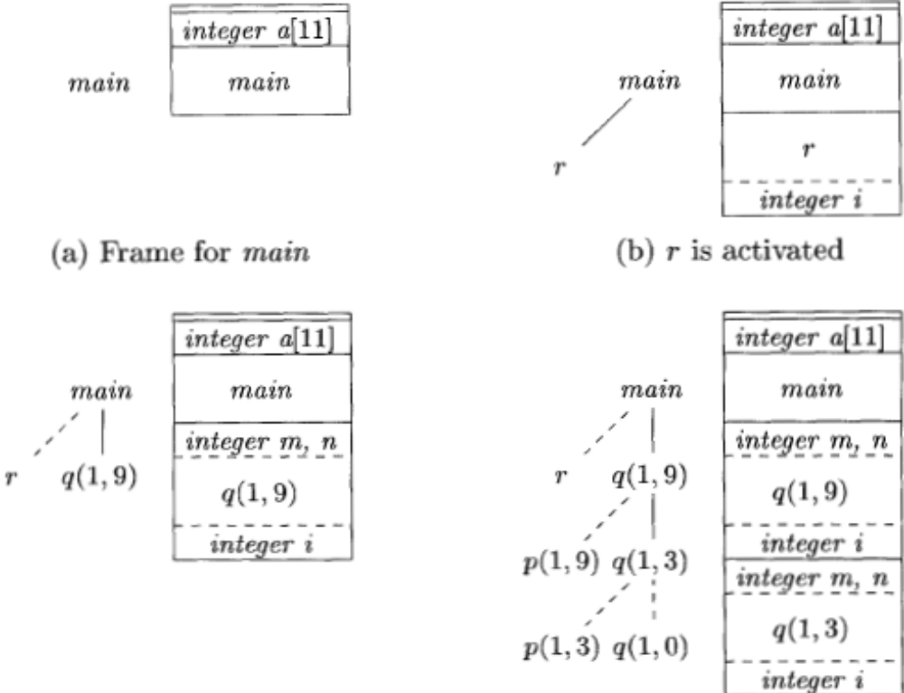
Downward-growing stack of activation records
(refer to the code for quick sort)
d) Control returns to q(1,3)
c) r is popped and q(1,9) pushed onto stack; i is local variable

Slide 20
Details
When control reaches the first call in the body of main, procedure r is activated, and its activation record is pushed onto the stack. The top of stack is at the bottom of diagrams. When control returns from this activation, its record is popped, leaving just the record for main on the stack.
Control then reaches the call to q (quicksort) with actual parameters 1 and 9, and an activation record for this call is placed on the top of the stack. The activation record for q contains space for the parameters m and n and the local variable i, following the general layout. Space once used by the call of r is reused on the stack. No trace of data local to r will be available to q(1, 9). When q(1, 9) returns, the stack again has only the activation record for main.
Several activations occur between the last two snapshots. A recursive call to q(l,3) was made. Activations p ( l , 3 ) and q(1,0) have begun and ended during the lifetime of q(l, 3), leaving the activation record for q(l, 3).
When a procedure is recursive, it is normal to have several of its activation records on the stack at the same time.

Slide 21
Designing Calling Sequences: principles
Values communicated between caller and callee are generally placed at the beginning of callee’s activation record
Fixed-length items: are generally placed at the middle
Items whose size may not be known early enough: are placed at the end of activation record
We must locate the top-of-stack pointer judiciously: a common approach is to have it point to the end of fixed length fields.

Slide 22
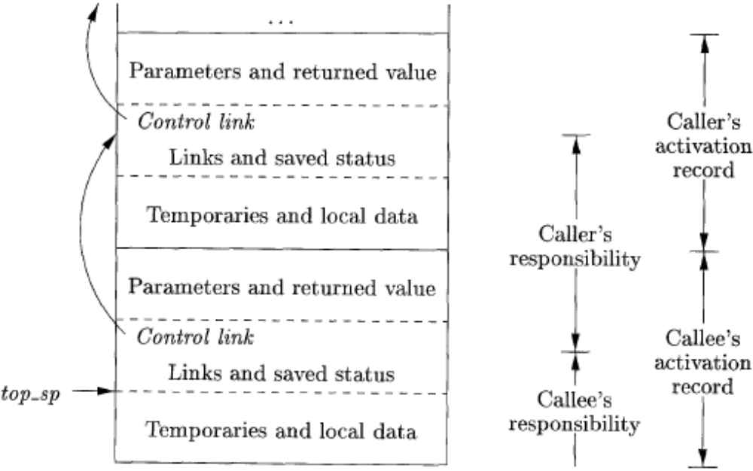
Division of tasks between caller and callee

Slide 23
Calling sequence
The caller evaluates the actual parameters
The caller stores a return address and the old value of top-sp into the callee's activation record.
The callee saves the register values and other status information.
The callee initializes its local data and begins execution.

Slide 24
Corresponding return sequence
The callee places the return value next to the parameters
Using information in the machine-status field, the callee restores top-sp and other registers, and then branches to the return address that the caller placed in the status field.
Although top-sp has been decremented, the caller knows where the return value is, relative to the current value of top-sp; the caller therefore may use that value.

Slide 25
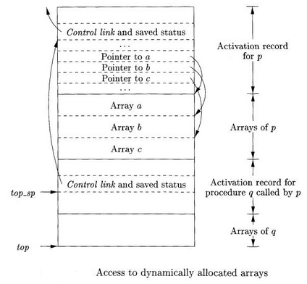
Variable length data on the stack
All variable length data is pointed to from the local data area.
Variable length arrays : size of array depending on the value of parameter/s of the called procedures.
Procedure p has 3 local arrays for which size cannot be determined at compile time. Array storage is not part of the activation record; Only pointer to array.

Slide 26
Variable length data on stack
Two pointers are used: top and top-sp.
top marks actual top of the stack , pointing to the position at which next activation record will begin.
top-sp finds the local fixed length fields of the top activation record and it points to the end of the machine status field. In specific for end of activation record for q.
When a procedure p is executing, the pointers are at known offsets from the top of the stack pointer

Slide 27
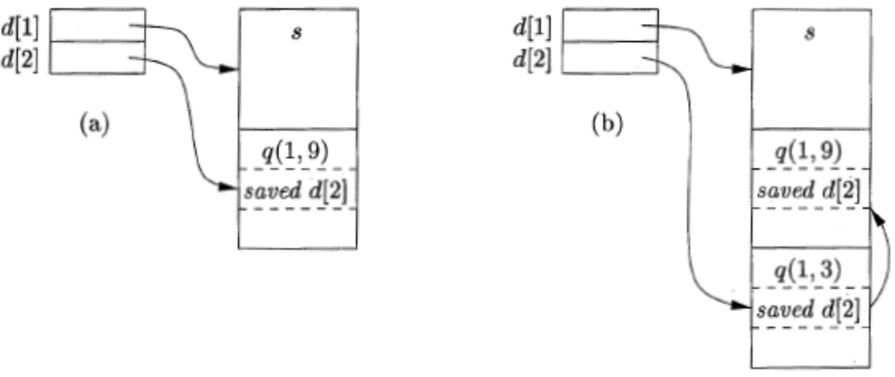
Maintaining the Display (extra)

Slide 28
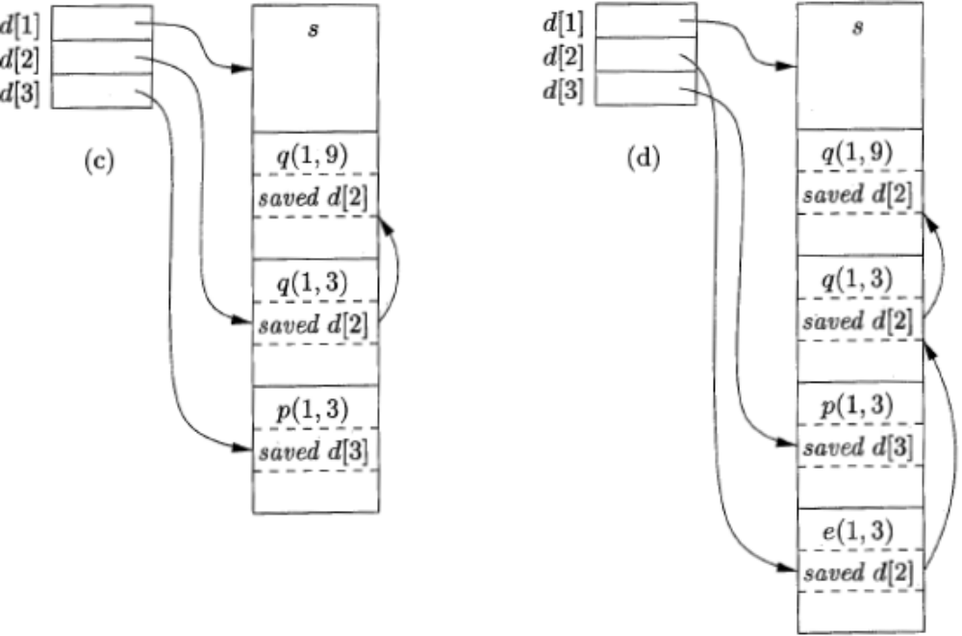
Maintaining the Display (Cont.)

